Slide 1

Drivers of rent: October 2022 Update
Nam Ngo (HUD)

Slide 2
Why are we interested in this?
Rent is more closely related to the (wellbeing) outcomes
renters typically pay a larger proportion of their incomes on housing costs compared to homeowners
Rent price could be a better signal of the supply-demand imbalance in the housing market
it reflects the “true” cost of housing consumption
Research on drivers of rent are quite limited, both internationally and in NZ

Slide 3
Approach
We have identified a list of possible factors that may drive rent from the literature:
Variables | Channel | Expected sign
Lagged rent inflation | Persistence | +
Income/wage | Renters’ ability to pay | +
Relative demand and supply |  | +
Home loan credit conditions | Homeownership rate | -
General inflation | Landlords’ expense | +
Labour market conditions, e.g unemployment rate | Job security Economic outlook | +
Interaction of two or more of the above

Slide 4
Approach
A simple, reduced-form equation with lags in order to reduce endogeneity issue
Main dependent variable: Rent inflation (Quarterly change of RPI)
Estimation period: Q1-2007 to Q1-2022

Slide 5
Most key variables have expected signs
 | Quarterly rent inflation | Quarterly rent inflation | Quarterly rent inflation | Quarterly rent inflation | Quarterly rent inflation
Predictors | Estimates | Estimates | Estimates | Estimates | Estimates
Rent inflation (1st lag) | -0.01 (0.13) | -0.10 (0.12) | -0.14 (0.12) | -0.15 (0.12) | -0.13 (0.12)
Rent inflation (2nd lag) | -0.24 * (0.13) | -0.32 ** (0.12) | -0.45 *** (0.13) | -0.46 *** (0.13) | -0.42 *** (0.14)
Rent inflation (3rd lag) | 0.06 (0.12) | 0.02 (0.11) | -0.08 (0.12) | -0.09 (0.12) | -0.05 (0.13)
Wage growth (deviation from sample mean 0.93, lagged) | 0.41 *** (0.14) | 0.40 *** (0.13) | 0.46 *** (0.13) | 0.44 *** (0.13) | 0.45 *** (0.13)
People per dwelling (deviation from sample mean 2.57, lagged) |  | 6.43 ** (2.41) | 6.36 *** (2.28) | 6.67 *** (2.33) | 7.63 *** (2.71)
Change in floating mortgage rate (lagged) |  |  | 0.05 ** (0.02) | 0.05 ** (0.02) | 0.04 * (0.02)
General inflation (lagged) |  |  |  | 0.12 (0.16) | 0.16 (0.17)
Unemployment rate (lagged) |  |  |  |  | 0.10 (0.14)
Observations | 56 | 56 | 56 | 56 | 56
R² / R² adjusted | 0.470 / 0.393 | 0.539 / 0.461 | 0.597 / 0.518 | 0.602 / 0.513 | 0.606 / 0.508
* p<0.1 ** p<0.05 *** p<0.01
Notes:
Interpretation in the next slide

Slide 6
Interpreting key coefficients
Variables | Change | Effect
Wage | 1 percentage points increase in growth of average weekly earnings | 0.45 percentage points increase in rent inflation
Relative demand and supply | 200,000 additional people or 74,000 less dwellings from Q1-2022 level | 0.7 percentage points increase in rent inflation
Home loan credit conditions | 10 percent increase in floating mortgage rate from same time last year | 0.4 percentage points increase in rent inflation
General inflation | 1 percent increase in general inflation | 0.16 percent increase in rent inflation

Slide 7
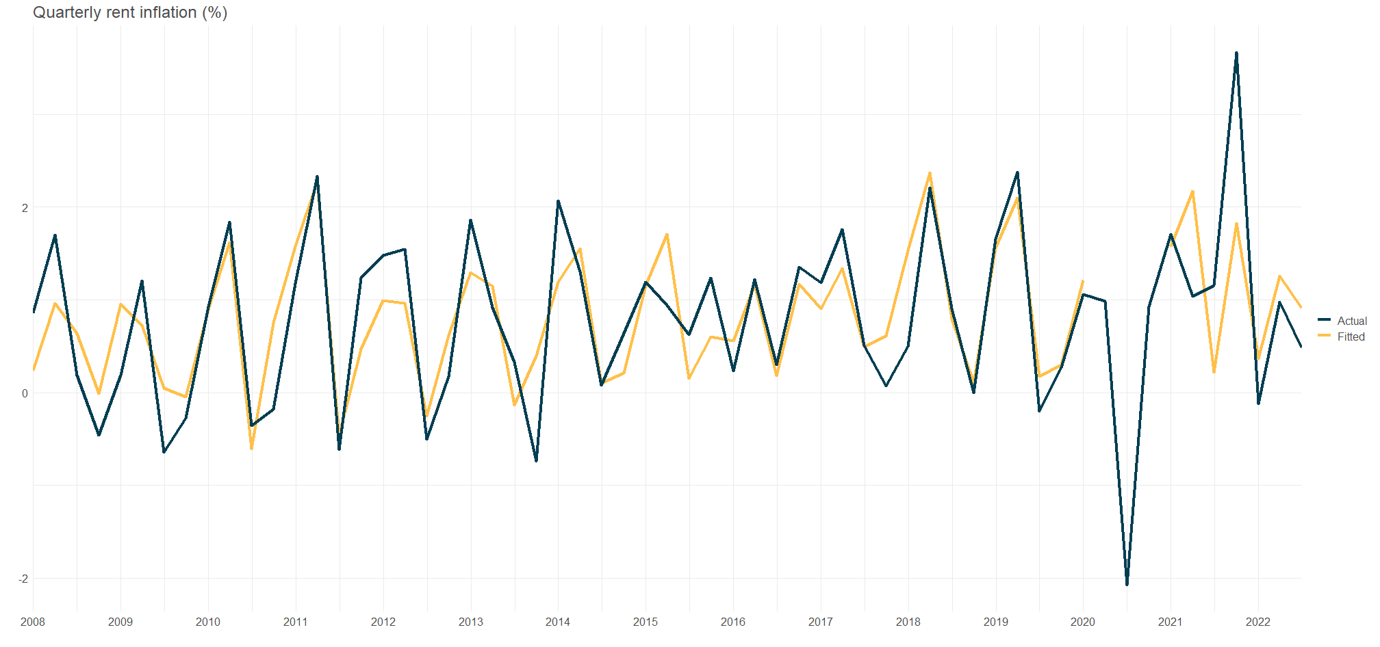
Notes:
Fitted

Slide 8
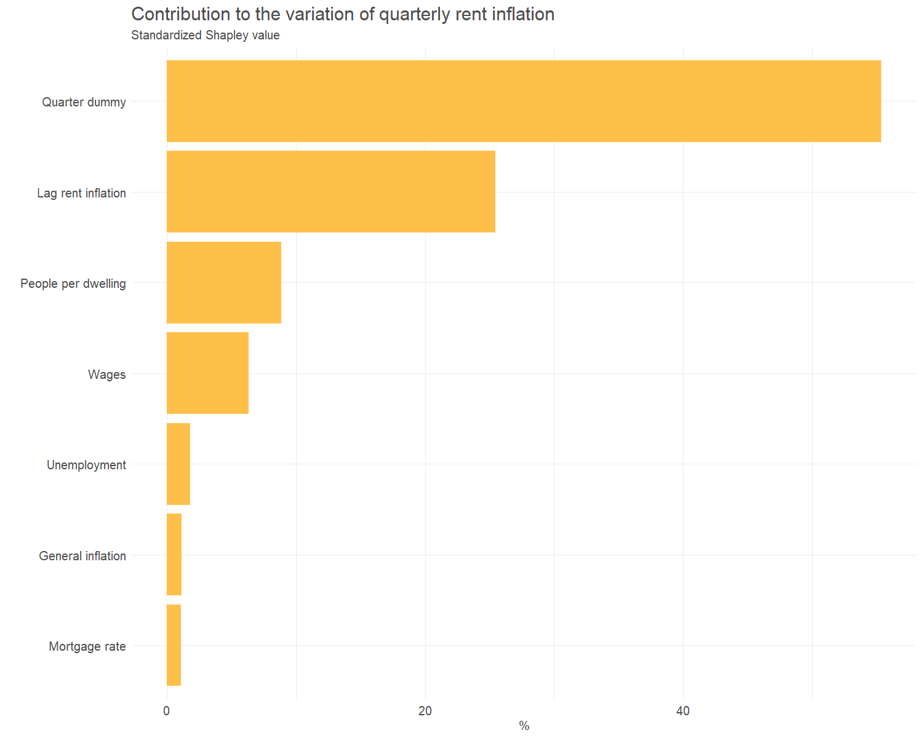

Slide 9
Non-quality adjusted measure of rent
 | Quarterly rent inflation | Quarterly rent inflation
Predictors | RPI (quality adjusted) | Geometric mean (Non-quality adjusted)
Rent inflation (1st lag) | -0.13 (0.12) | -0.29 *** (0.10)
Rent inflation (2nd lag) | -0.43 *** (0.14) | -0.17 * (0.10)
Rent inflation (3rd lag) | -0.05 (0.14) | -0.17 * (0.10)
Wage growth (deviation from sample mean 0.8, lagged) | 0.45 *** (0.13) | 0.36 * (0.19)
People per dwelling (deviation from sample mean 2.59, lagged) | 7.78 *** (2.80) | 6.19 * (3.29)
Change in floating mortgage rate (lagged) | 0.04 ** (0.02) | 0.06 *** (0.02)
General inflation (lagged) | 0.14 (0.17) | -0.23 (0.29)
Unemployment rate (lagged) | 0.09 (0.14) | -0.30 ** (0.12)
Observations | 56 | 111
R² / R² adjusted | 0.605 / 0.506 | 0.582 / 0.536
* p<0.1 ** p<0.05 *** p<0.01
Notes:
Results do not change much using the non-quality adjusted rent inflation
Geomean instead of median (Rent comes in round numbers so median rents tend to plateau, not suitable for quarterly analysis)
Unemployment rate has expected sign now
Geomean change = price change + quality change + amenities change
Smaller impact of wage on all change compared to on price change suggest that wage gains get capitalized into pure price change more than quality/amenities improvement

Slide 10
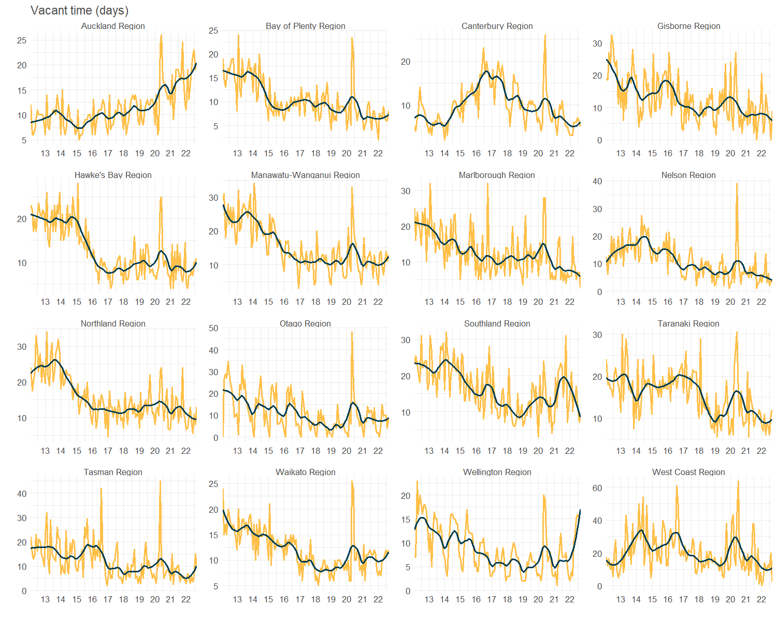
Vacant time (vacancy rate) as an alternative measure of relative supply and demand
Notes:
People per dwelling is slow moving, with lags and might involve interpolation at regional level
Vacant time by property address ID (new tenancies)
Auckland/Wellington vs Gisborne, Canterbury, Northland, etc

Slide 11
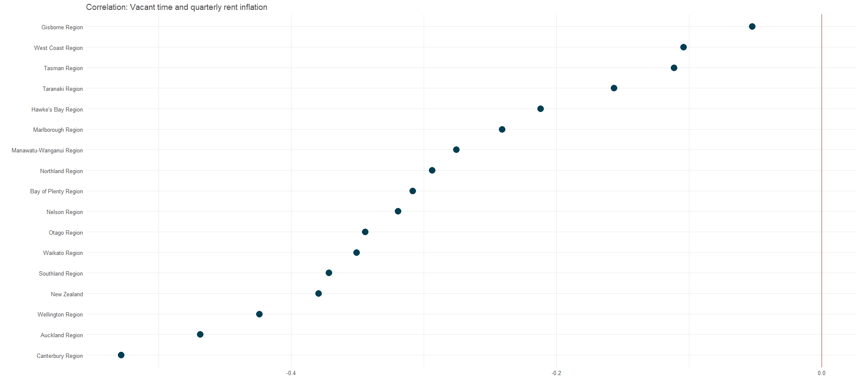
Clear negative correlations between vacant time and rent inflation, at national and regional level

Slide 12
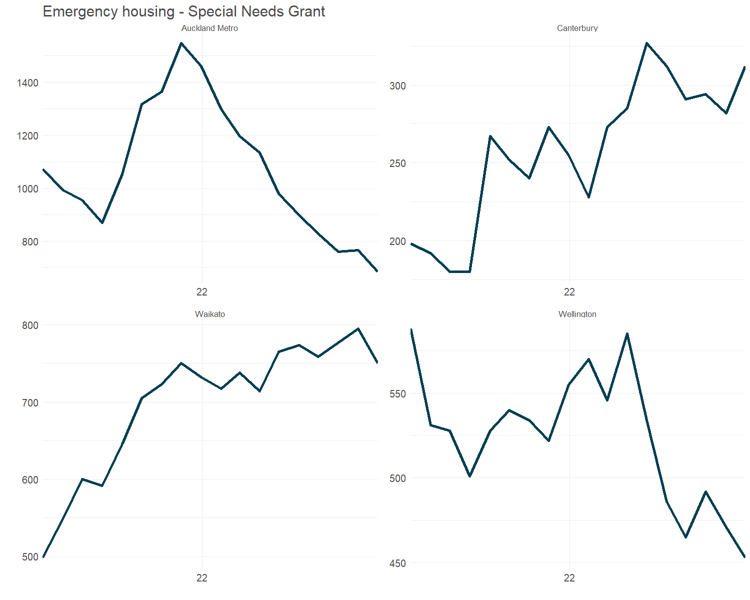
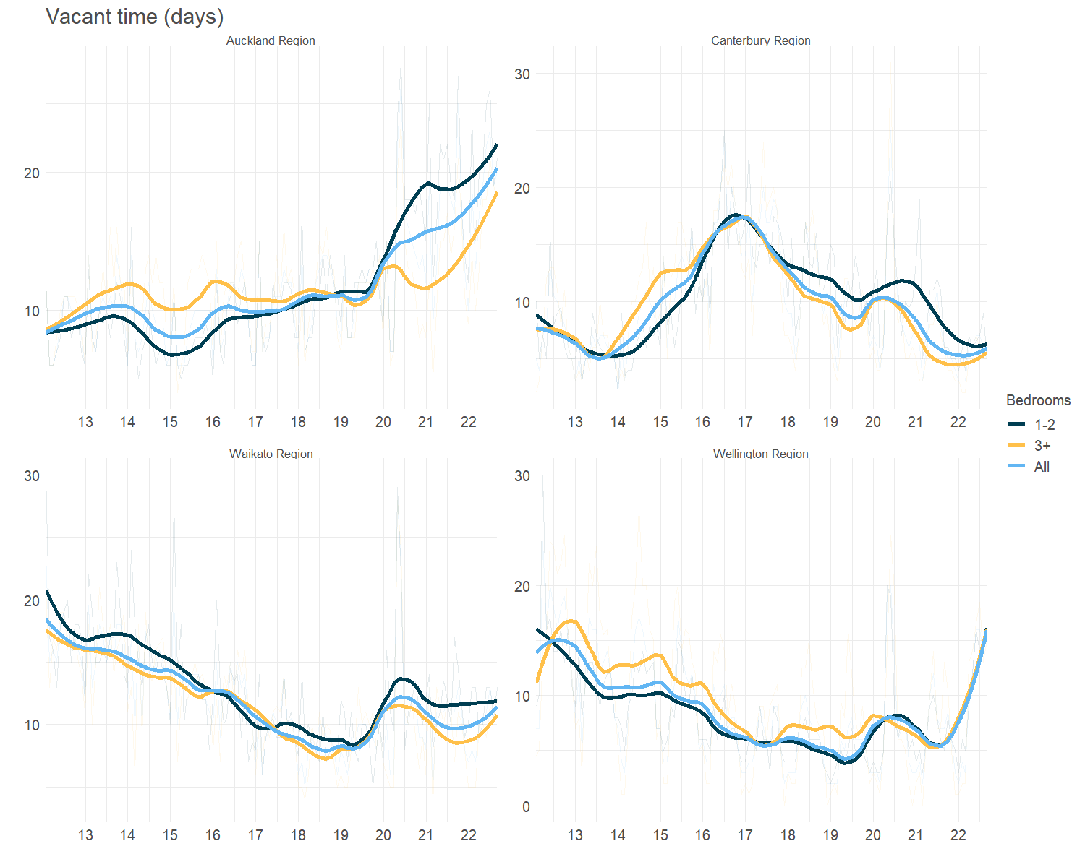
Vacant time measures for different segments of the rental market can also be useful for demand/price forecasting

Slide 13
Vacant time (vacancy rate) as an alternative measure of relative supply and demand
 | Quarterly rent inflation | Quarterly rent inflation
Predictors | Estimates | Estimates
Wage growth (deviation from sample mean 0.93, lagged) | 0.45 *** (0.13) | 0.41 *** (0.14)
People per dwelling (deviation from sample mean 2.57, lagged) | 7.63 *** (2.71)
Change in vacant time |  | -0.20 ** (0.08)
Observations | 56 | 56
R² / R² adjusted | 0.606 / 0.508 | 0.599 / 0.499
* p<0.1 ** p<0.05 *** p<0.01

Slide 14
The larger the supply and demand gap, the stronger the correlation between wage and rent
 | Quarterly rent inflation | Quarterly rent inflation
Predictors | Estimates | Estimates
Wage growth (deviation from sample mean 0.93, lagged) | 0.46 *** (0.14) | 0.56 (0.63)
People per dwelling (deviation from sample mean 2.57, lagged) | 7.48 *** (2.76)
Wage growth x People per dwelling | 1.12 (2.61)
Change in vacant time (lagged) |  | -0.20 ** (0.08)
Wage growth x Change in vacant time |  | -0.01 (0.05)
Observations | 56 | 56
R² / R² adjusted | 0.608 / 0.499 | 0.600 / 0.488
* p<0.1 ** p<0.05 *** p<0.01
Notes:
Higher people per dwelling (more demand relative to supply) => stronger relationship between wage and rents
Higher vacancy rate (more supply relative to demand) => weaker relationship between wage and rents
Higher vacant time (properties take longer to fill => more supply relative to demand) => weaker relationship between wage and rents

Slide 15
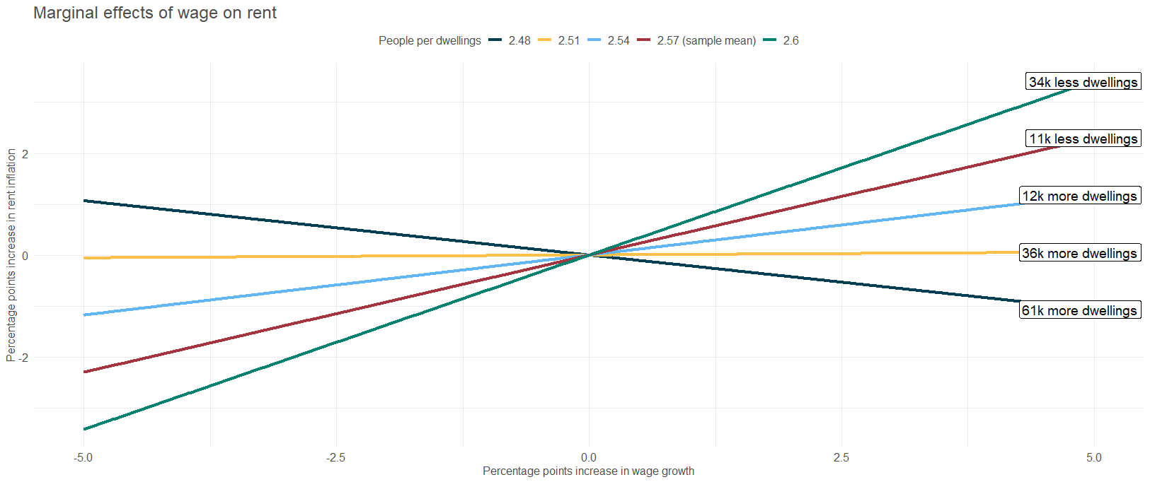
The bigger the supply and demand gap, the stronger the correlation between wage and rent

Slide 16
Key takeaways
Wages, relative supply and demand, and credit conditions are the main drivers of rent
Overall, the explanatory variables can explain around 50-60% of the variation
Rent and wage tend to track each other over time. However, the bigger the supply and demand gap, the stronger the impact of wage on rent

Slide 17
Next steps
Panel regression at regional level
Look at how the key coefficients vary at regional level

Slide 18
Plan for write up
Short executive summary with key takeaways
Analytical notes/research paper
Timeframe
Notes:
Summary first vs analytical notes

